Slide 1
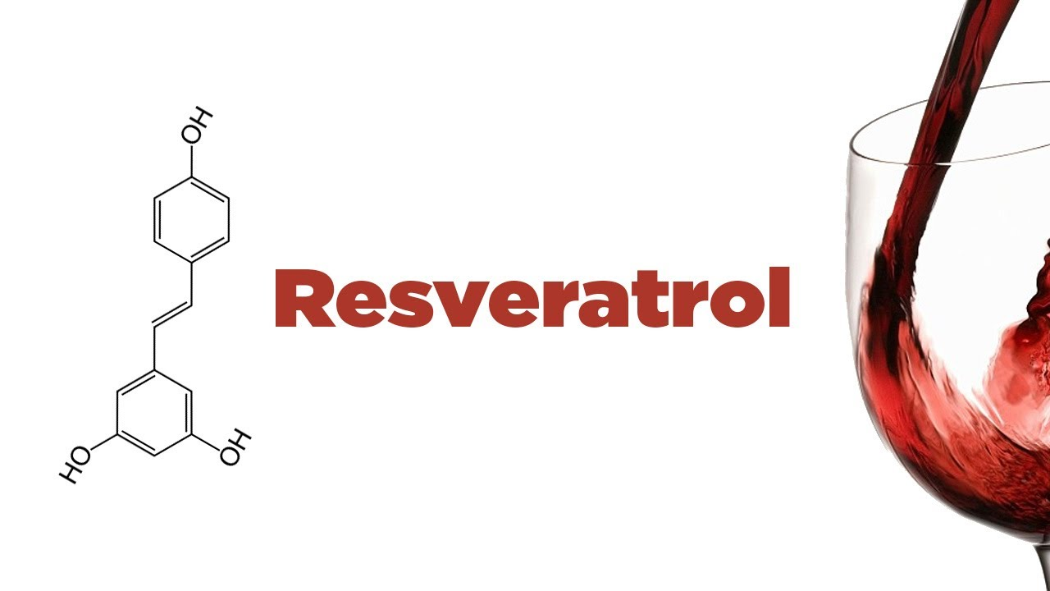
INFO 8000 Final Project
Professor: Kyle Johnsen
Student: Lei Lou

Slide 2
Content
Background
Resveratrol
Binding protein
From AA to Protein
Things about ML models
Details
Part 1 - Clustering
Part 2 - Classification
Results
Future Work

Slide 3
Content
Background
Resveratrol
Binding protein
From AA to Protein
Things about ML models
Details
Part 1 - Clustering
Part 2 - Classification
Results
Future Work

Slide 4
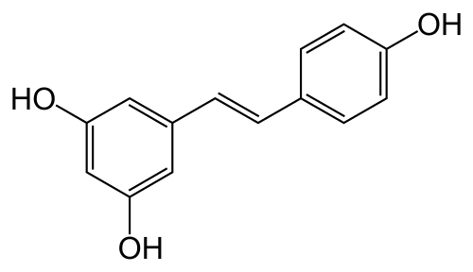
Molecular formula
Background / Details / Results / Future Work

Slide 5
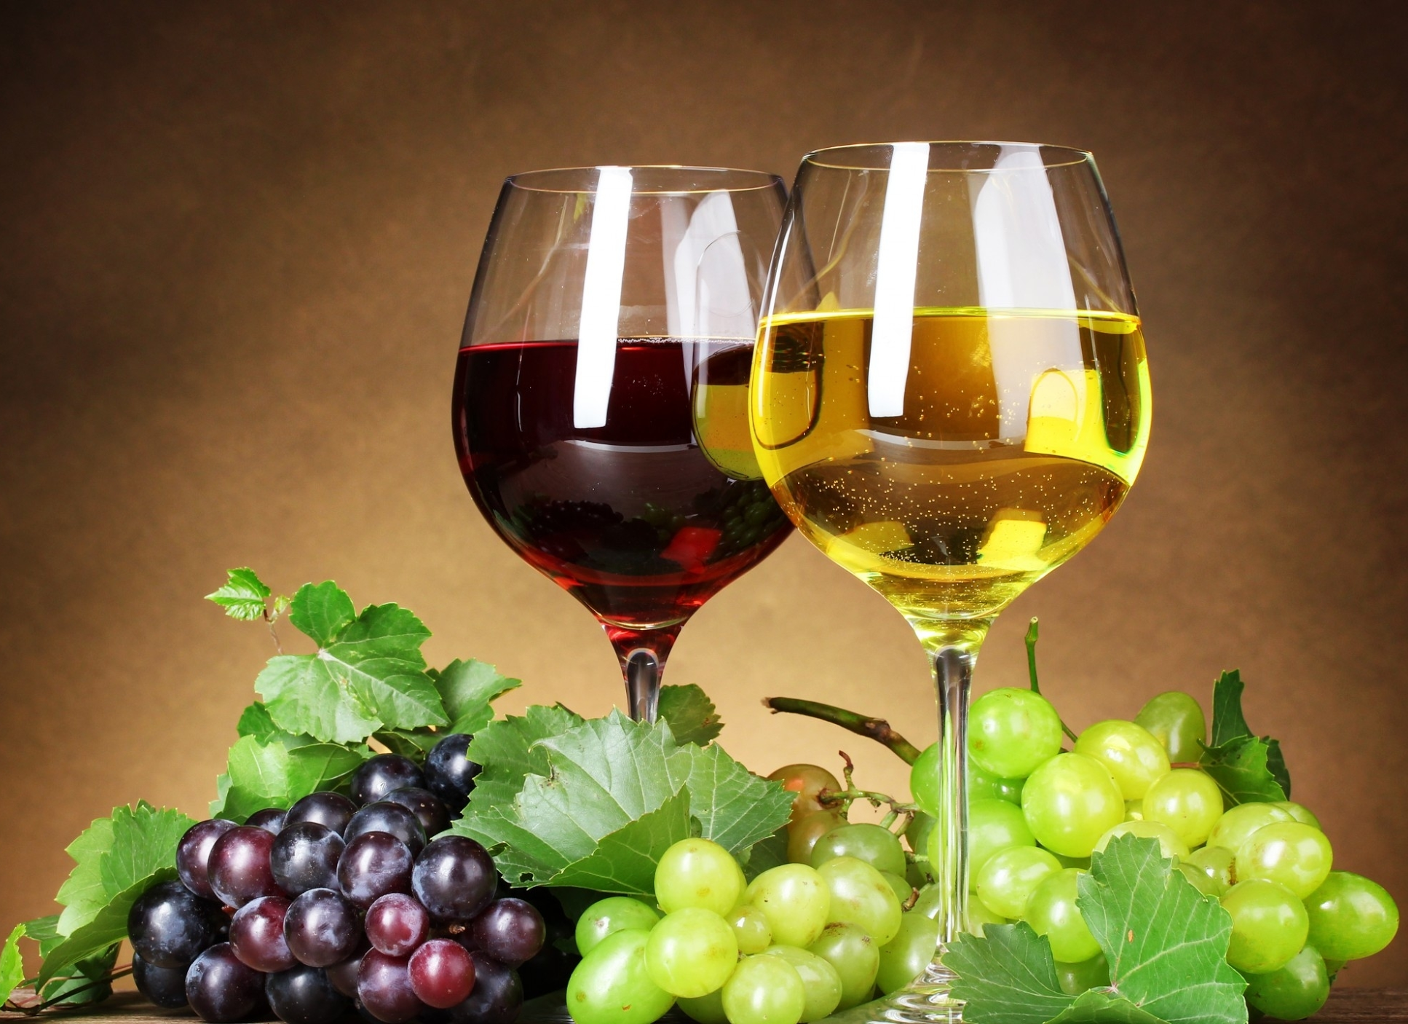
Beverage | Resveratrol (mean/range) (mg/150 ml)
Red wine | 0.27 / 0 —2.78
Rosé wine | 0.12 / 5.00e-03—0.29
White wine | 0.04 / 0.00—0.17
Sparkling wine | 9.00e-03 / 8.00e-03 —1.00e-02
Green grape juice | 5.08e-03 / 0.00 —1.00e-02
Background / Details / Results / Future Work

Slide 6
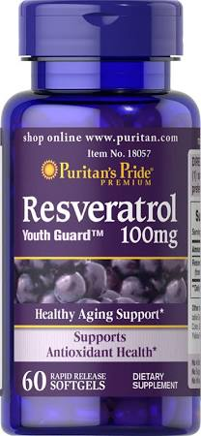
Products
A daily supplement
Heart disease
Cancer
Metabolism
Lifespan
?
Background / Details / Results / Future Work

Slide 7
History
1939, Michio Takaoka(Japan) first derived it from plant roots.
1980s, The Japanese scientists started to do research on the Antioxidant effect.
1990s, Dipak Kumar Das in University of Connecticut came up with a theory that the Resveratrol in Grape wine explained French Paradox.
2012, University of Connecticut dismissed Professor Dipak K. Das due to the fraud in the study resveratrol
Background / Details / Results / Future Work

Slide 8
Content
Background
Resveratrol
Binding protein
From AA to Protein
Things about ML models
Details
Part 1 - Clustering
Part 2 - Classification
Results
Future Work

Slide 9
Binding protein
A binding protein is any protein that acts as an agent to bind two or more molecules together.
Background / Details / Results / Future Work

Slide 10
DNA binding protein
Proteins composed of DNA-binding domains
have a specific or general affinity for either single or double stranded DNA.
Generally in the major groove if the binding is sequence-specific – as with transcription factors that regulate expression of genes, and nucleases that cleave DNA between nucleotides.
Can also bind DNA non-specifically, such as polymerases and histones.
About 6%~7% are DNA binding protein
Background / Details / Results / Future Work

Slide 11
Content
Background
Resveratrol
Binding protein
From AA to Protein
Things about ML models
Details
Part 1 - Clustering
Part 2 - Classification
Results
Future Work

Slide 12
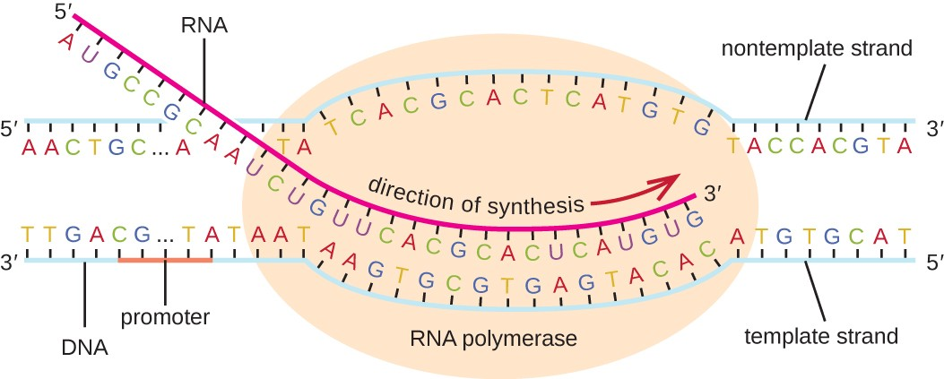
Biosynthesis (Transcription and translation)
Background / Details / Results / Future Work

Slide 13
Content
Background
Resveratrol
Binding protein
From AA to Protein
Things about ML models
Details
Part 1 - Clustering
Part 2 - Classification
Results
Future Work

Slide 14
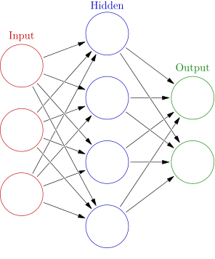
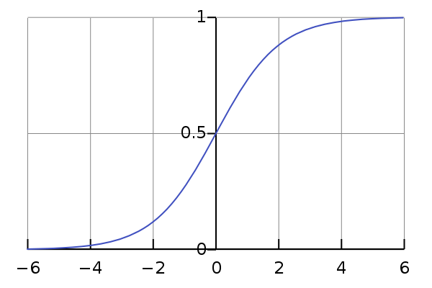
Neural Network
Simulate creatures’ neuron
Accept multiple inputs with different weight and output signal to other neurons
Better for feature learning
Use functions like Sigmoid to simulate signal strength
Background / Details / Results / Future Work

Slide 15
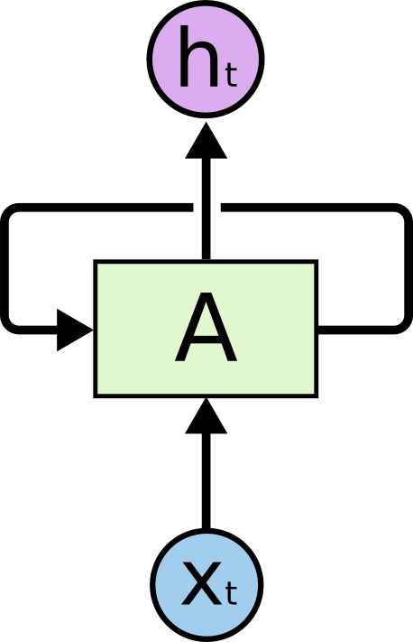

LSTM
LSTM stands for Long Short-Term Memory
LSTM is one of the models of Recurrent Neural Network
Accept previous output as one of the inputs, to simulate “memory”
Better for sequence learning
Background / Details / Results / Future Work

Slide 16

TensorFlow
Open-source software library by Google
Built for machine learning
Can run on GPU for high performance
Background / Details / Results / Future Work

Slide 17
Content
Background
Resveratrol
Binding protein
From AA to Protein
Things about ML models
Details
Part 1 - Clustering
Part 2 - Classification
Results
Future Work

Slide 18
Features
Total Number of Atom
Total Number of Amino Acid
Atom Percentage
We chose four atoms and calculate their percentage (C, O, N, S)
Some PDB files may ignore Hydrogen so we don't use it
Amino Acid Percentage
We calculated the percentage for all 20 amino acids
Volume
Use 3-D grid to approximate volume calculation
Light up the point near each object
Calculate the lit point to get the volume
Total of 27 dimensions
Background / Details / Results / Future Work

Slide 19
Hierarchical
K-means is better at handling larger datasets, since it’s result is too random on small datasets
K-NN may get slow in high dimensions
Hierarchical can provide the whole tree-like structure so that we can backtrace to find out the sweet spot
Background / Details / Results / Future Work

Slide 20
CODE TIME

Slide 21
Content
Background
Resveratrol
Binding protein
From AA to Protein
Things about ML models
Details
Part 1 - Clustering
Part 2 - Classification
Results
Future Work

Slide 22
Features
Most characteristics change too much among all the proteins
Amino acid sequence will be the only feature we use
Background / Details / Results / Future Work

Slide 23
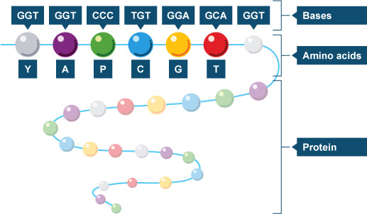
AA sequence
Background / Details / Results / Future Work

Slide 24
Comparing to DNA sequence
The order of DNA sequence is very significant.
So we value the sequence order of the protein sequence
Background / Details / Results / Future Work

Slide 25
Why LSTM?
Other machine learning models accept features, not great for sequence recognition
Protein not only is amino acids, but also is sequenced amino acid
The output of pure LSTM is also a sequence
We can easily apply another neural network model on top of LSTM to get the True/False answer
Background / Details / Results / Future Work

Slide 26
CODE TIME

Slide 27
Content
Background
Resveratrol
Binding protein
From AA to Protein
Things about ML models
Details
Part 1 - Clustering
Part 2 - Classification
Results
Future Work

Slide 28
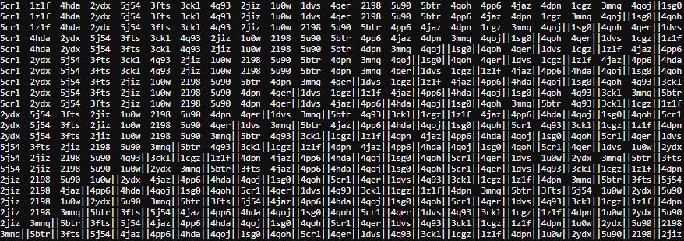
Part 1
Background / Details / Results / Future Work

Slide 29
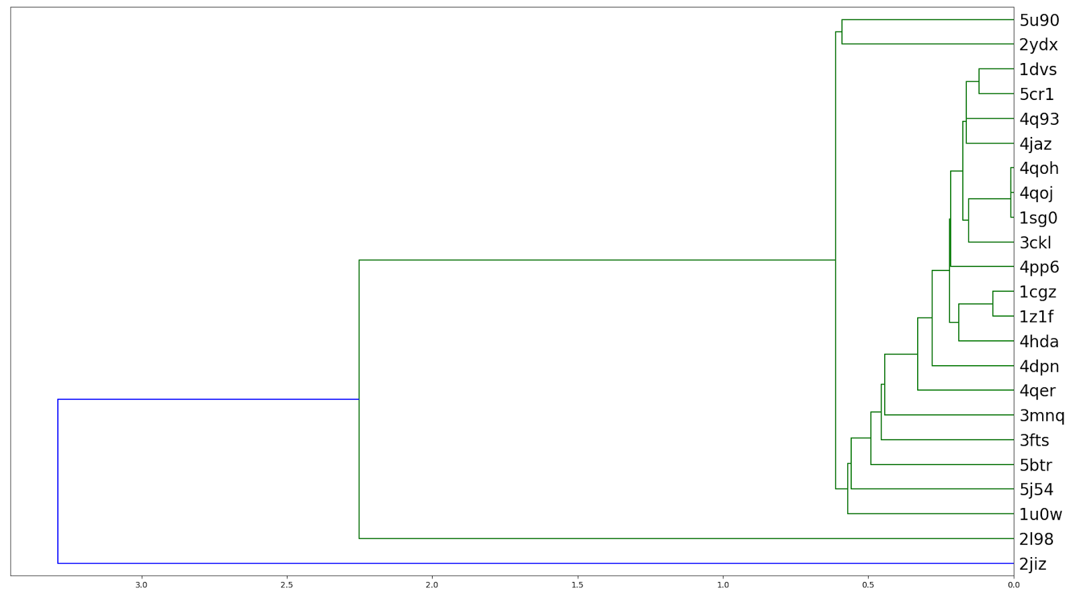

Slide 30
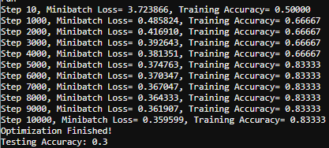
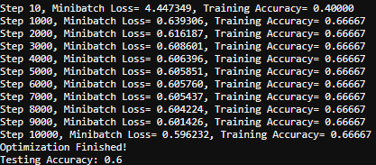
Part 2 - result 1
RNN (256 units)
Training iterations: 10,000
Learning rate: 0.001
Time: ~4 mins
Training/Testing ratio: 80%/20%
Background / Details / Results / Future Work

Slide 31
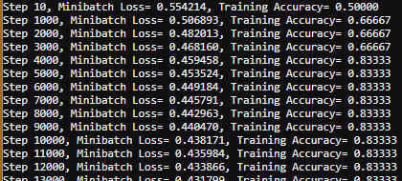
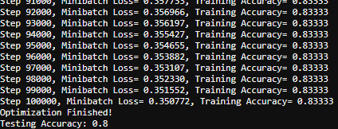
Part 2 - result 2
RNN (256 units)
Training iterations: 100,000
Learning rate: 0.0001
Time: ~27 mins
Training/Testing ratio: 80%/20%
Background / Details / Results / Future Work

Slide 32
Content
Background
Resveratrol
Binding protein
From AA to Protein
Things about ML models
Details
Part 1 - Clustering
Part 2 - Classification
Results
Future Work

Slide 33
Future Work
Expand training datasets to more proteins
Can use the “shape” as one of the features
Electronic charge
Background / Details / Results / Future Work

Slide 34

Thank you

